Slide 1
Swarm Robotics
Samriddh Bhalla - 16116057
Shubhanshu Agarwal - 16118078

Slide 2
Components Used
Tiva Microcontroller
NodeMCU
Motor Driver
LSA - Advanced Auto-Calibrating Line Sensor

Slide 3
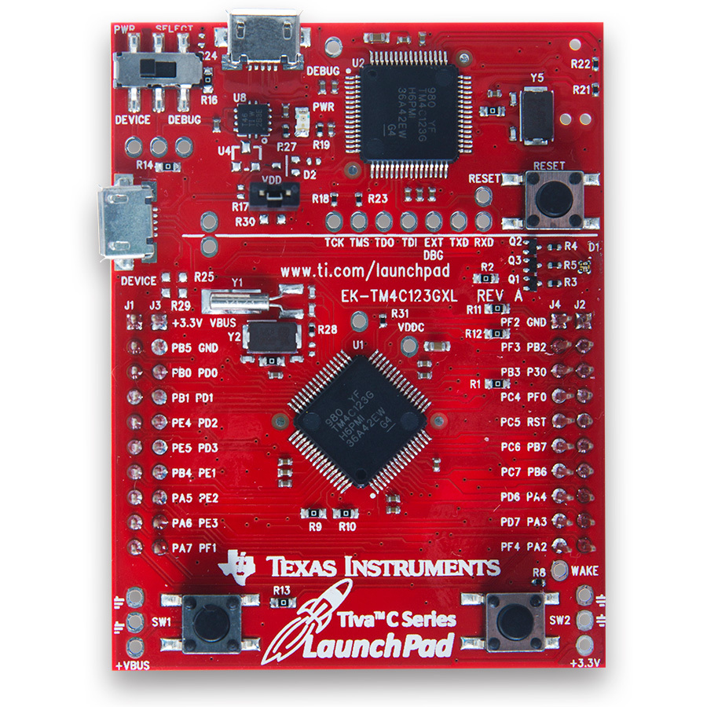
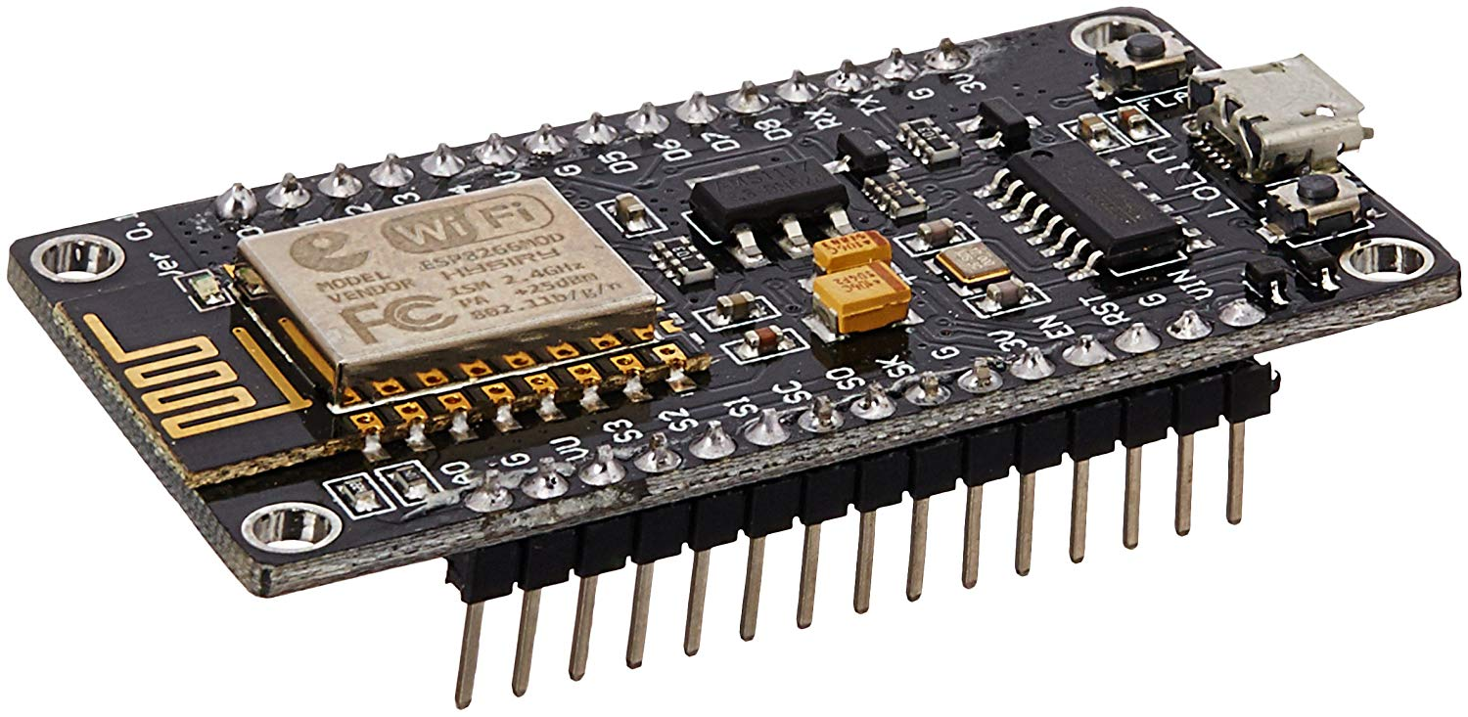
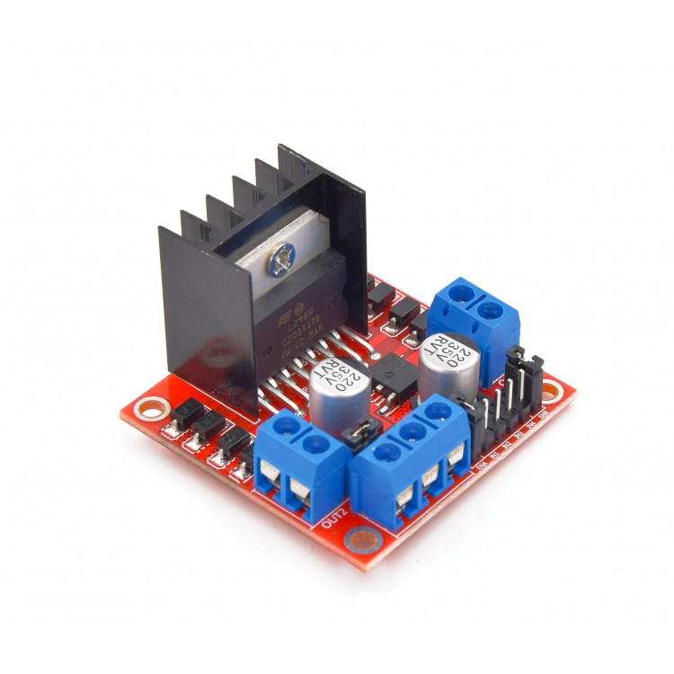
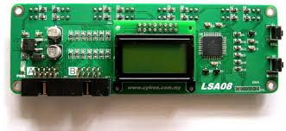
Components Used
Tiva Microcontroller
NodeMCU
Motor Driver
LSA - Advanced Auto-Calibrating Line Sensor

Slide 4
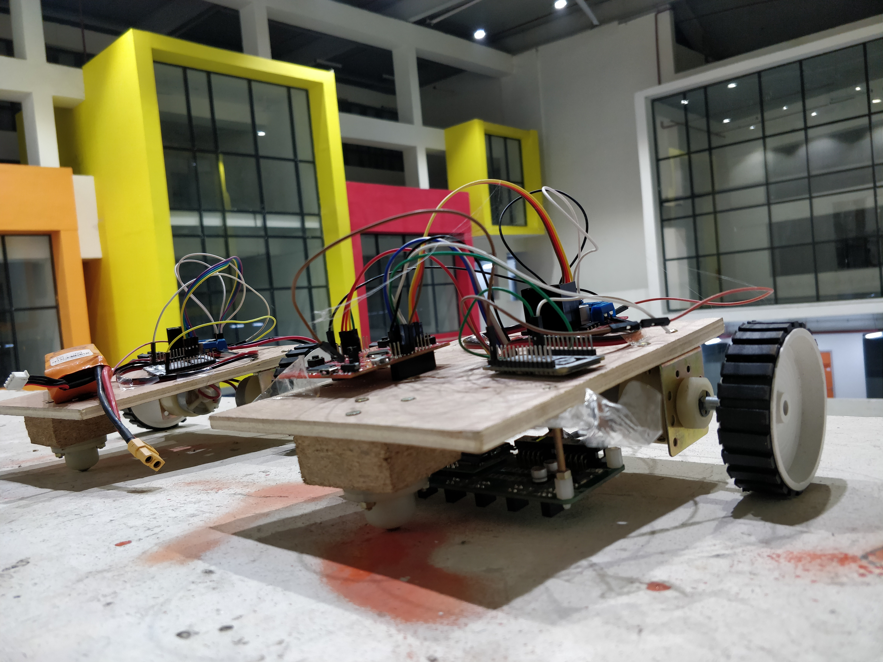
Summary
Two bots
First one -> Line Following
Second One -> Copies the movement of the first bot
Fig. 1 From left to right - Bot 2, Bot 1

Slide 5
Block Diagram
BOT 1
BOT 2
LSA Senses White Line
Tiva Processes Input From LSA
NodeMCU Transmits Motor Driver Parameter
Corresponding Motor is Driven
ROUTER
NodeMCU Receives Motor Driver Parameter
Corresponding Motor is Driven

Slide 6
Working of LSA
LSA has 8 IR sensors
O/P calibrated as 1 for White Line & 0 for Background - sw
Weights of the IR sensor - [ 1, 1, 1, 1, -1, -1, -1, -1 ] - w
W_sum = ∑ w[i] * sw[i]

Slide 7
Challenges
Interfacing of two node MCU such that the delay is minimum
Optimizing code to minimize the delay on the TIVA Board.
Using UART between TIVA Board and Node MCU

Slide 8
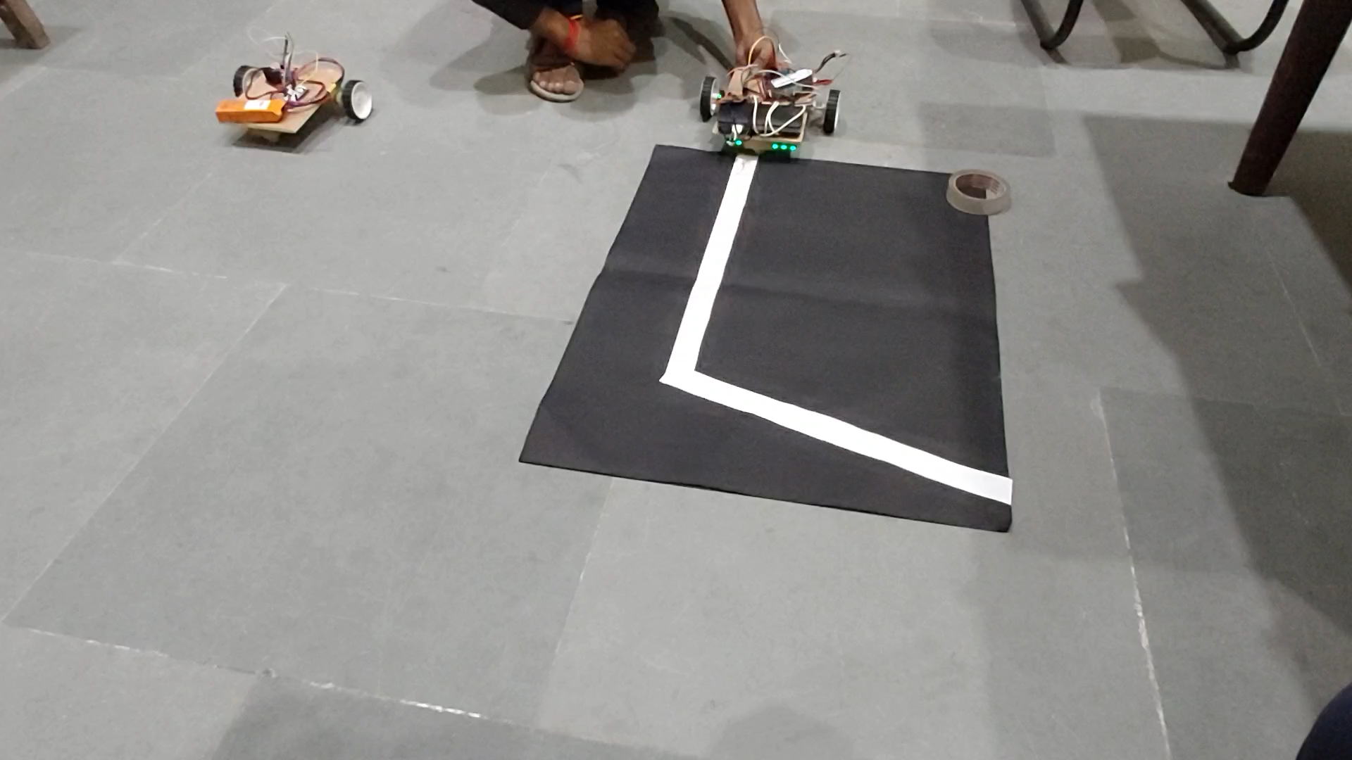
Results

Slide 9

Thank you

